Slide 1
Course Overview
General structure and purpose of Open UAV Course for Team - FW

Slide 2
Users:

Slide 3
General structure
In this section the contents and thought ways will be introduced. The structure may be modified slightly but the general idea is frozen before the 1st version.
Structure to follow

Slide 4
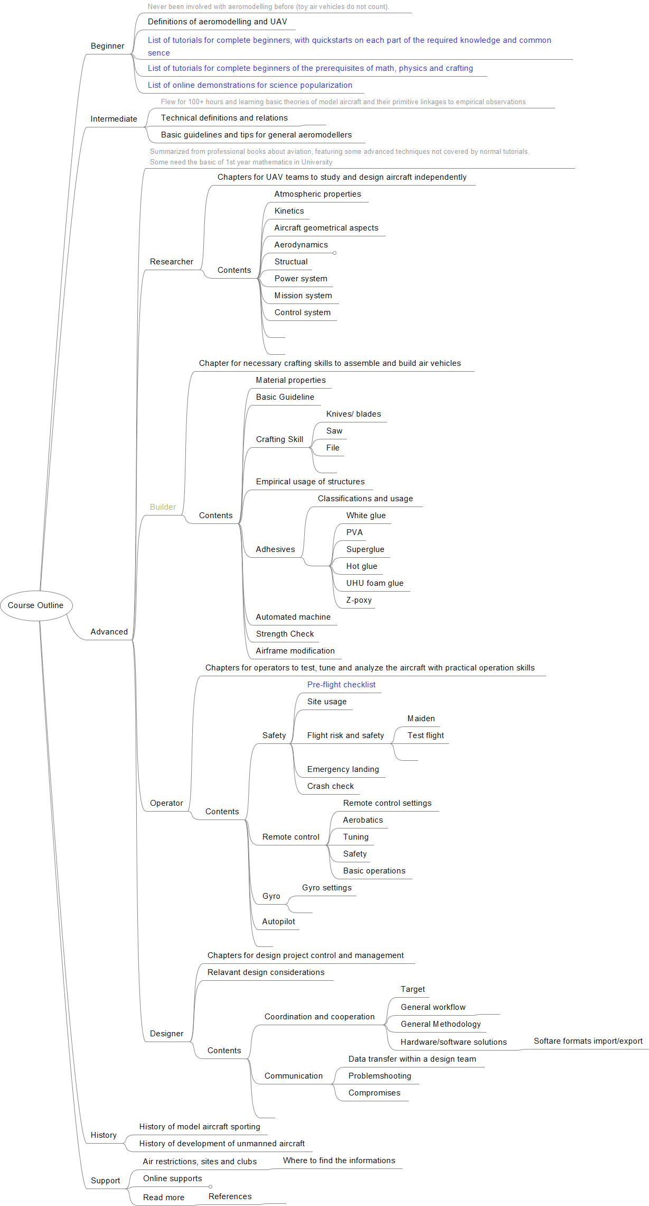
Current outline of course (master branch)

Slide 5
File contents
What goes into, what does not go into each folder

Slide 6
File contents
A main mindmap is under the ‘source’ folder
The structure is shown with a mindmap on each topic
The files are within folders (which is very primitive).
Each folders should contain a mindmap of its subfolders, and a presentation introducing itself briefly.

Slide 7
Contents of each topic folder
Each topic folder may have:
A mind map in .png(Open with picture softwares) , with the source file .svg(open with browsers, edit with vector editing softwares, e.g. illustrator ), or .mm (open with FreeMind)
A presentation a .html (open with browser) or a .pptx (with Office Powerpoint )is necessary. Sometimes .md(markdown), .rmd(R markdown) will be available.
A worksheet of list of resources (usually .xlsx).
1 or more diagrams, some with the source file in .dia (Open and edit with Dia or rollApp). External sources (demonstrations, videos) will be linked there.

Slide 8
Recommended usage of the materials
For Individual learners: Read and follow the tutorials or use as reference
For Students: Printing on paper is permitted with reference.
For Educators: Use for education (including lecture presentation, demonstrations). If you want your own structure of teaching, feel free to branch your own distribution.
For Developers: You can print out mind maps as cheat sheets. And use the report templates.
For Researchers: The list of external links may be helpful.

